Slide 1

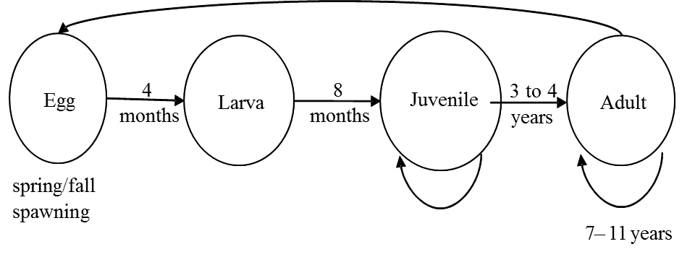
Species’ Needs
INDIVIDUAL
Notes:
Here’s another life cycle conceptual model. (No two are alike! Pick the one that best fits the information you need to convey.) What were the life stages that you diagrammed for the Island Mouse? (Answer: nestling, juvenile, adult)
Breaking it apart like this helps us explore the needs of individuals to complete each life stage. This example is an aquatic species with four life stages. Our questions in developing an SSA include – What influences survival, growth, and reproduction at the egg, larva, juvenile, and adult life stages? In other words, what is needed for breeding, feeding and sheltering at each stage? The answers to these questions help us understand what the species needs for survival, growth, and reproduction at the individual level. (We will start at the individual level and scale up to population and species later today.)
(This will also directly relate to our discussion on viability later in the week.)

Slide 2
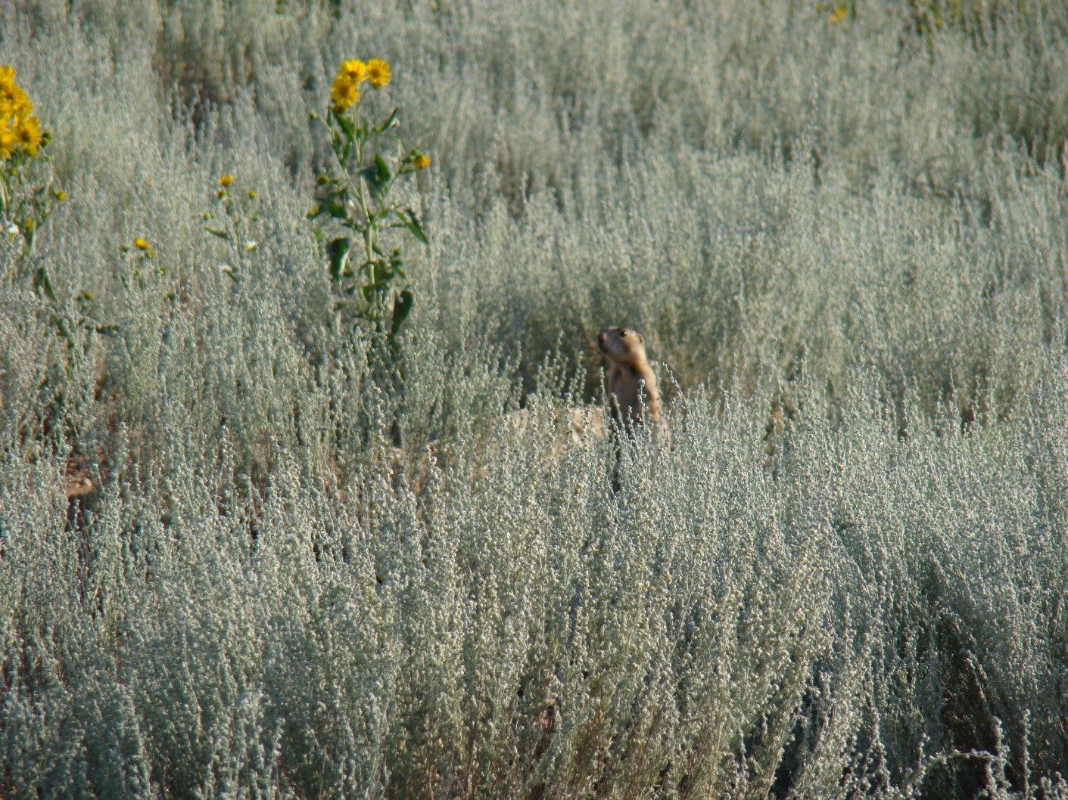
Species’ Needs
INDIVIDUAL
Habitat
Notes:
We have covered the Taxonomy and Life History, so now it is time to start describing the relationship between the species and its habitat. The biological interactions and habitat requirements help us understand how individuals at each life stage respond to natural and anthropogenic influences.
Pictured here is an adult prairie dog. Just for the adult life stage of this species, what resources would you say it needs for feeding? (It eats grass and tubers) What does the adult prairie dog need for shelter? (THINK HABITAT) …and what does the adult need for breeding? (Friable soils, low grass cover around burrows, connectivity between populations, etc…)
In order for us to understand the 3Rs and viability (where we are headed with the SSA), we need to first collect the pieces of information that will inform those analyses. So, now we will now develop Habitat and Resource Needs by Life Stage.

Slide 3
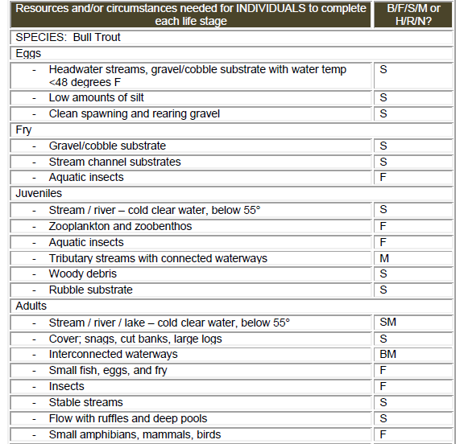

Species’ Needs
INDIVIDUAL
Ecological
Needs –
Individuals
Notes:
One way to approach Ecological Needs at the Individual level , or “Resource Needs by Life Stage”, is to create another Table.
Here is a simple Table that was created for bull trout. The first column (click) identifies the Life Stage, the second (click) lists some resources specific to each life stage, and the third tells if those resources are needed for Breeding, Feeding, Sheltering, or M (Migration). If you are working on a plant, resource functions would be Habitat (H), Reproduction (R), and Nutrition (N) instead of BFS (which is for animals).

Slide 4
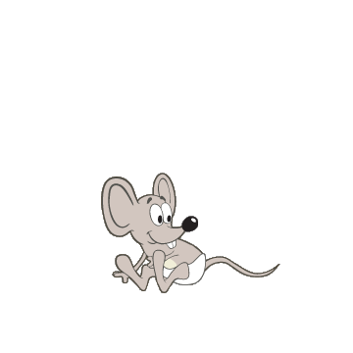
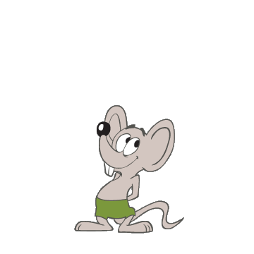
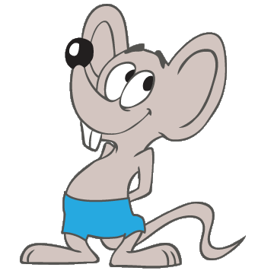
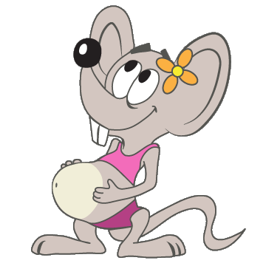
Species’ Needs
INDIVIDUAL
EXERCISE 2.
Resource Needs by Life Stage
Notes:
For this exercise, They return to their population groups and work together to fill out the Table in their exercise book, identifying what resources and circumstances are needed for each life stage of nestling, juvenile, and adult.
Some of this information can come from the earlier discussion on the species overview from Ex. 1, but now they can also look more closely at habitat descriptions in the interactive map. Each group will have the interactive map file (thumb drive), and they can scroll over each population to see more detailed information.
As they are exploring the interactive map, if the coach sees that they have found an Easter Egg (the hidden bits of information), they can then hand out paper copies of the fact sheets.
After they have completed their lists, have the class come back together and go around the room, group by group to report out RNs by lifestage. Make one combined list (on a flip chart or marker board) and suggest that everyone add to their lists as needed. This is a good example of how “group thinking” creates more robust information…and how to be inclusive of everyone’s input.

